Slide 1

Guide to Networking Essentials 7th Edition
Topic 04
Network Hardware in Depth
Notes:
Network+ Guide to Networks 7th Edition
Chapter 8
Network Hardware in Depth

Slide 2
Objectives
Describe the advanced features and operation of network switches
Describe routing table properties and discuss routing protocols
Explain basic and advanced wireless access point features
Select the most suitable NIC bus and features for a computer
Notes:
Objectives
Describe the advanced features and operation of network switches
Describe routing table properties and discuss routing protocols
Explain basic and advanced wireless access point features
Select the most suitable NIC bus and features for a computer

Slide 3
Network Switches in Depth
Switches work at the Data Link layer (Layer 2)
Receive frames on one port and forward them out the port where the destination device can be found
Switches send broadcast frames out all ports (for broadcast)
Each switch port is considered a collision domain
Switches do not forward collision information to any other ports
Switch ports can operate in full-duplex mode
Allows connected devices to transmit and receive simultaneously, eliminating the possibility of a collision
Notes:
Network Switches in Depth
Switches work at the Data Link layer (Layer 2)
Receive frames on one port and forward them out the port where the destination device can be found
Switches send broadcast frames out all ports
Each switch port is considered a collision domain
Switches do not forward collision information to any other ports
Switch ports can operate in full-duplex mode
Allows connected devices to transmit and receive simultaneously, eliminating the possibility of a collision

Slide 4
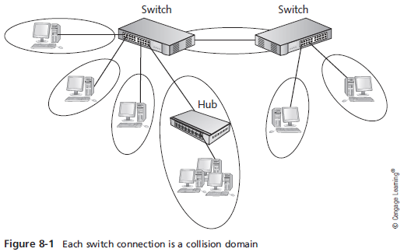
Network Switches in Depth
Notes:
Network Switches in Depth

Slide 5
Switch Port Modes of Operation
Ports on a typical 10/100 Mbps switch can usually operate in these modes:
10 Mbps half-duplex
100 Mbps half-duplex
10 Mbps full-duplex
100 Mbps full-duplex
Notes:
Switch Port Modes of Operation
Ports on a typical 10/100 Mbps switch can usually operate in these modes:
10 Mbps half-duplex
100 Mbps half-duplex
10 Mbps full-duplex
100 Mbps full-duplex

Slide 6
Switch Port Modes of Operation
Most inexpensive switches run in auto-negotiate mode
The switch sets the mode to the highest performance setting the connected device supports
Auto-MDIX mode – switch port detects the type of device and cable it’s connected to
A straight-through or crossover cable can be used
Notes:
Switch Port Modes of Operation
Most inexpensive switches run in auto-negotiate mode
The switch sets the mode to the highest performance setting the connected device supports
Auto-MDIX mode – switch port detects the type of device and cable it’s connected to
A straight-through or crossover cable can be used

Slide 7
Creating the Switching Table
A switching table holds MAC address/port pairs that tell the switch where to forward a frame, based on the destination MAC address
Ports also have their respective MAC addresses
When a switch is first powered on, its table is empty
As network devices send frames, the switch reads each frame’s source address and adds it to the table along with the port it was received from
If a frame’s destination address isn’t found in the switching table the switch forwards the frame out all ports (broadcast)
Notes:
Creating the Switching Table
A switching table holds MAC address/port pairs that tell the switch where to forward a frame, based on the destination MAC address
When a switch is first powered on, its table is empty
As network devices send frames, the switch reads each frame’s source address and adds it to the table along with the port it was received from
If a frame’s destination address isn’t found in the switching table the switch forwards the frame out all ports

Slide 8
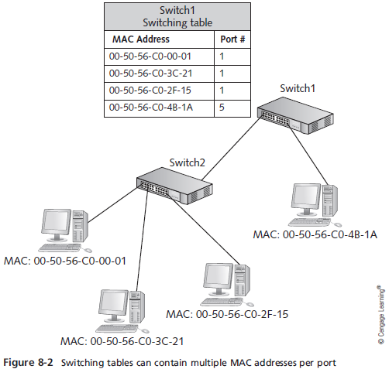
Creating the Switching Table
Notes:
Creating the Switching Table

Slide 9
Creating the Switching Table
Most switches include a number that indicates the number of MAC addresses the switch can hold
Example: 8K MAC addresses supported
Switching tables prevent stale entries by including a timestamp when an entry is created
When a switch receives a frame from a device already in it’s table, it updates the entry with a new timestamp
The period of time a table keeps a MAC address is called the aging time
If the timestamp isn’t updated within the aging time, the entry expires and is removed from the table
Notes:
Creating the Switching Table
Most switches include a number that indicates the number of MAC addresses the switch can hold
Example: 8K MAC addresses supported
Switching tables prevent stale entries by including a timestamp when an entry is created
When a switch receives a frame from a device already in it’s table, it updates the entry with a new timestamp
The period of time a table keeps a MAC address is called the aging time
If the timestamp isn’t updated within the aging time, the entry expires and is removed from the table

Slide 10
Frame Forwarding Methods
Cut-through switching – switch reads only enough of the incoming frame to determine the frame’s source and destination address (fastest method)
Disadvantage: no error checking
Store-and-forward switching – switch reads the entire frame into its buffers before forwarding it
Switch examines the FCS field to make sure it contains no errors before forwarding the frame (checks with CRC)
Fragment-free switching – switch reads enough of the frame to guarantee that it’s at least the minimum size for the network type
Notes:
Frame Forwarding Methods
Cut-through switching – switch reads only enough of the incoming frame to determine the frame’s source and destination address (fastest method)
Disadvantage: no error checking
Store-and-forward switching – switch reads the entire frame into its buffers before forwarding it
Switch examines the FCS field to make sure it contains no errors before forwarding the frame
Fragment-free switching – switch reads enough of the frame to guarantee that it’s at least the minimum size for the network type

Slide 11
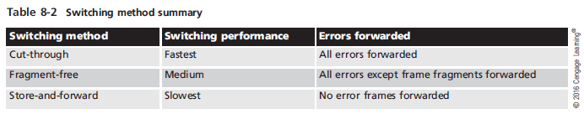
Frame Forwarding Methods
Notes:
Frame Forwarding Methods

Slide 12
Advanced Switch Features
High-end switches, often referred to as “smart switches” and “managed switches”, can help make a network more efficient and reliable
The following slides are an overview of the most common features found in “smart switches”, such as:
Multicast processing
Spanning Tree Protocol
Virtual local area networks
Port security
Notes:
Advanced Switch Features
High-end switches, often referred to as “smart switches” and “managed switches”, can help make a network more efficient and reliable
The following slides are an overview of the most common features found in “smart switches”, such as:
Multicast processing
Spanning Tree Protocol
Virtual local area networks
Port security

Slide 13
Advanced Switch Features
Multicast processing – Switches process multicast frames in one of two ways
As broadcasts and sends them out all ports
Used by low-end switches or those that have not been configured for it
By forwarding the frames only to ports that have registered the multicast address
Used by switches that support Internet Group Management Protocol (IGMP)
Multicast MAC addresses always begin with 01:00:5E
The rest of the address identifes a particular multicast application
Notes:
Advanced Switch Features
Multicast processing – Switches process multicast frames in one of two ways
As broadcasts and sends them out all ports
Used by low-end switches or those that have not been configured for it
By forwarding the frames only to ports that have registered the multicast address
Used by switches that support Internet Group Management Protocol (IGMP)
Multicast MAC addresses always begin with 01:00:5E
The rest of the address identifes a particular multicast application

Slide 14
Advanced Switch Features
Spanning Tree Protocol (STP) – Enables switches to detect when there is a potential for a switching loop
Occurs when a frame is forwarded from one switch to another in an infinite loop)
When a possible loop is detected:
One of the switch ports goes into blocking mode, preventing it from forwarding frames that would create a loop
If the loop configuration is broken, the switch that was in blocking mode resumes forwarding frames
Notes:
Advanced Switch Features
Spanning Tree Protocol (STP) – Enables switches to detect when there is a potential for a switching loop
Occurs when a frame is forwarded from one switch to another in an infinite loop)
When a possible loop is detected:
One of the switch ports goes into blocking mode, preventing it from forwarding frames that would create a loop
If the loop configuration is broken, the switch that was in blocking mode resumes forwarding frames

Slide 15
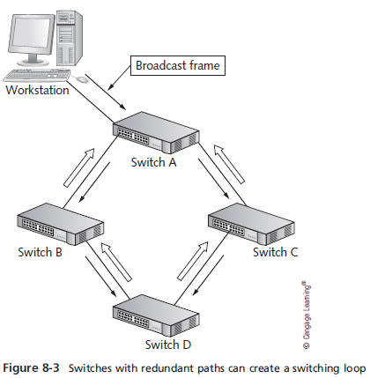
Advanced Switch Features
Notes:
Advanced Switch Features

Slide 16
Advanced Switch Features
A side effect of STP:
Devices take longer to create a link with a switch that runs the protocol
Rapid Spanning Tree Protocol (RSTP)
An enhancement to STP that provides faster convergence when the topology changes
Notes:
Advanced Switch Features
A side effect of STP:
Devices take longer to create a link with a switch that runs the protocol
Rapid Spanning Tree Protocol (RSTP)
An enhancement to STP that provides faster convergence when the topology changes

Slide 17
Advanced Switch Features
Virtual Local Area Networks (VLANS) – enable you to configure one or more switch ports into separate broadcast domains
It’s like separating a switch into two or more switches that aren’t connected to one another
A router is needed to communicate between VLANs
Improves management and security of the network and gives more control of broadcast frames
Allows administrators to group users and resources logically instead of by physical location
Notes:
Advanced Switch Features
Virtual Local Area Networks (VLANS) – enable you to configure one or more switch ports into separate broadcast domains
It’s like separating a switch into two or more switches that aren’t connected to one another
A router is needed to communicate between VLANs
Improves management and security of the network and gives more control of broadcast frames
Allows administrators to group users and resources logically instead of by physical location

Slide 18
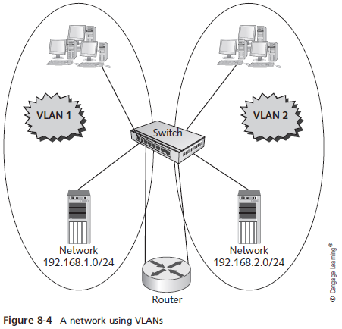
Advanced Switch Features
Notes:
Advanced Switch Features

Slide 19
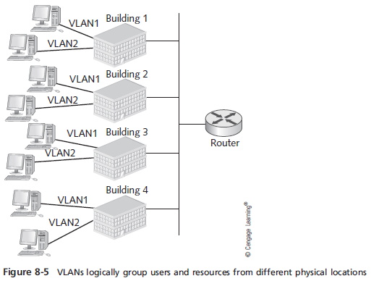
Advanced Switch Features
Notes:
Advanced Switch Features

Slide 20
Advanced Switch Features
VLAN Trunks
A trunk port is a switch port configured to carry traffic from all VLANs to another switch or router
The switch or router port must also be configured as a trunk port
Involves the switch adding a tag to each frame that must traverse the trunk port
The VLAN tag identifies which VLAN the traffic originated from
Notes:
Advanced Switch Features
VLAN Trunks
A trunk port is a switch port configured to carry traffic from all VLANs to another switch or router
The switch or router port must also be configured as a trunk port
Involves the switch adding a tag to each frame that must traverse the trunk port
The VLAN tag identifies which VLAN the traffic originated from

Slide 21
Advanced Switch Features
Factors to consider before using VLANs
Overuse of VLANs can cost more than it benefits you
More VLANs mean more logical networks so your network will be more complicated
Every VLAN you create requires a corresponding router interface
Routers are slower devices, so performance can decrease with the addition of more VLANs
More router interfaces mean additional IP networks, which is likely to require subnetting your existing network
Notes:
Advanced Switch Features
Factors to consider before using VLANs
Overuse of VLANs can cost more than it benefits you
More VLANs mean more logical networks so your network will be more complicated
Every VLAN you create requires a corresponding router interface
Routers are slower devices, so performance can decrease with the addition of more VLANs
More router interfaces mean additional IP networks, which is likely to require subnetting your existing network

Slide 22
Advanced Switch Features
Switch Port Security – In some public buildings, network jacks with connections to switches are often available to public users, who can easily plug in a laptop that contain viruses, hacker tools, and other malware
A switch with port security features can help prevent this type of connection
Enables an administrator to limit how many and which MAC addresses can connect to a port
If an unauthorized computer attempts to connect, the port can be disabled and a message can be sent to the administrator to alert them of the intrusion
Notes:
Advanced Switch Features
Switch Port Security – In some public buildings, network jacks with connections to switches are often available to public users, who can easily plug in a laptop that contain viruses, hacker tools, and other malware
A switch with port security features can help prevent this type of connection
Enables an administrator to limit how many and which MAC addresses can connect to a port
If an unauthorized computer attempts to connect, the port can be disabled and a message can be sent to the administrator to alert them of the intrusion

Slide 23
Multilayer Switches
Some advanced devices have all the functions of a managed switch (Layer 2) but add Layer 3 capabilities
Typically used in the interior of networks to route between VLANs instead of being placed on the network perimeter
Offer performance advantage over traditional routers
Packet routing between VLANs is done within the switch instead of having to exit the switch to a router
Notes:
Multilayer Switches
Some advanced devices have all the functions of a managed switch (Layer 2) but add Layer 3 capabilities
Typically used in the interior of networks to route between VLANs instead of being placed on the network perimeter
Offer performance advantage over traditional routers
Packet routing between VLANs is done within the switch instead of having to exit the switch to a router

Slide 24
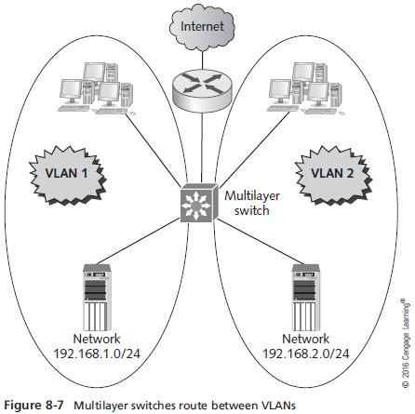
Multilayer Switches
Notes:
Multilayer Switches

Slide 25
Routers in Depth
Routers operate at the Network layer (Layer 3) and work with packets
Connect separate logical networks to form an internetwork
Broadcast frames are not forwarded to other router ports (other networks)
Routers can be used to create complex internetworks with multiple paths creating fault tolerance and load sharing
Notes:
Routers in Depth
Routers operate at the Network layer (Layer 3) and work with packets
Connect separate logical networks to form an internetwork
Broadcast frames are not forwarded to other router ports (other networks)
Routers can be used to create complex internetworks with multiple paths creating fault tolerance and load sharing

Slide 26
Routers in Depth
All processing done by routers depends on the following features found on most routers:
Router interfaces
Routing tables
Routing protocols
Access control lists
Notes:
Routers in Depth
All processing done by routers depends on the following features found on most routers:
Router interfaces
Routing tables
Routing protocols
Access control lists

Slide 27
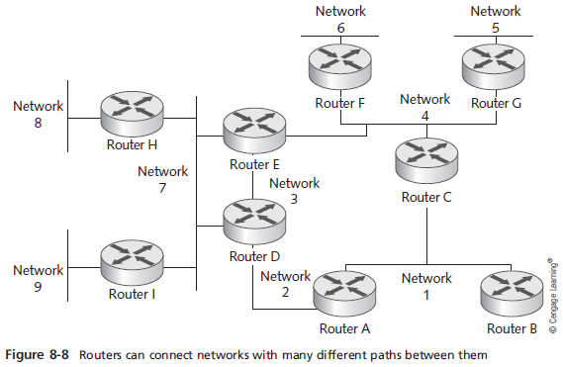
Routers in Depth
Notes:
Routers in Depth

Slide 28
Router Interfaces
Routers must have two or more interfaces (ports) in order to forward packets to other networks
When a router interface receives a frame it compares the destination MAC address with the interface’s MAC address
If they match, the router strips the frame header and trailer and reads the packet’s destination IP address
If the IP address matches it processes the packet
If the IP address does not match, the router consults its routing table to determine how to get the packet to the its destination
Process of moving a packet from the incoming interface to the outgoing interface is called packet forwarding
Notes:
Router Interfaces
Routers must have two or more interfaces (ports) in order to forward packets to other networks
When a router interface receives a frame it compares the destination MAC address with the interface’s MAC address
If they match, the router strips the frame header and trailer and reads the packet’s destination IP address
If the IP address matches it processes the packet
If the IP address does not match, the router consults its routing table to determine how to get the packet to the its destination
Process of moving a packet from the incoming interface to the outgoing interface is called packet forwarding

Slide 29
Router Interfaces
The following steps summarize how a router uses its interface to forward packets from one network to another:
A router receives a frame on an interface.
The router checks the frame’s destination MAC address.
If the destination MAC address matches the interface’s address, the router reads the frame; otherwise, the frame is discarded.
The frame header and trailer are stripped to create a packet.
The destination IP address is checked.
If the IP address’s network ID is different from the interface’s network ID, the packet should be routed.
The router consults the routing table to determine to which of its interfaces the packet should be forwarded.
The packet is encapsulated in a new frame header and trailer.
The packet is forwarded to the destination computer or the next router in the path.
Notes:
Router Interfaces
Routers must have two or more interfaces (ports) in order to forward packets to other networks
When a router interface receives a frame it compares the destination MAC address with the interface’s MAC address
If they match, the router strips the frame header and trailer and reads the packet’s destination IP address
If the IP address matches it processes the packet
If the IP address does not match, the router consults its routing table to determine how to get the packet to the its destination
Process of moving a packet from the incoming interface to the outgoing interface is called packet forwarding

Slide 30
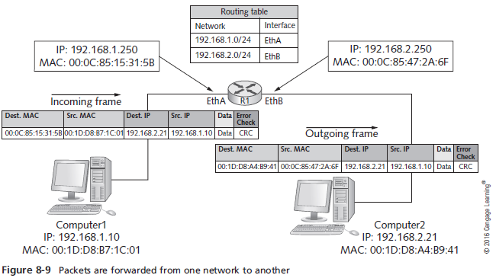
Router Interfaces
Notes:
Router Interfaces

Slide 31
Routing Tables
Routing tables are composed of network address and interface pairs that tell the router which interface a packet should be forwarded to
Most routing tables contain the following for each entry:
Destination network – usually expressed in CIDR notation such as 172.16.0.0/16
Next hop – The next hop indicates an interface name or the address of the next router in the path to the destination
Total number of routers a packet must travel through is called the hop count
Metric – Numeric value that tells the router how “far away” the destination network is (also called cost or distance)
Notes:
Routing Tables
Routing tables are composed of network address and interface pairs that tell the router which interface a packet should be forwarded to
Most routing tables contain the following for each entry:
Destination network – usually expressed in CIDR notation such as 172.16.0.0/16
Next hop – The next hop indicates an interface name or the address of the next router in the path to the destination
Total number of routers a packet must travel through is called the hop count
Metric – Numeric value that tells the router how “far away” the destination network is (also called cost or distance)

Slide 32
Routing Tables
Most routing tables contain the following for each entry (cont’d):
How the route is derived – This field tells you how the route gets into the routing table (one of 3 ways)
Network is connected directly
Administrator enters the route information manually (called a static route)
Route information is entered dynamically, via a routing protocol
Timestamp – Tells the router how long it has been since the routing protocol updated the dynamic route
Notes:
Routing Tables
Most routing tables contain the following for each entry (cont’d):
How the route is derived – This field tells you how the route gets into the routing table (one of 3 ways)
Network is connected directly
Administrator enters the route information manually (called a static route)
Route information is entered dynamically, via a routing protocol
Timestamp – Tells the router how long it has been since the routing protocol updated the dynamic route

Slide 33
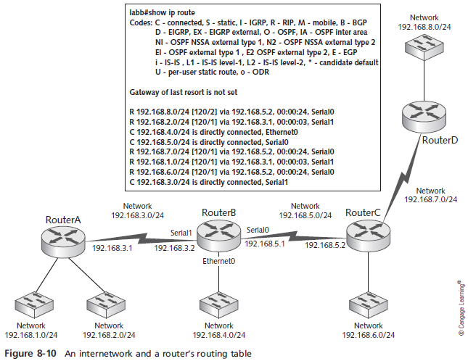
Routing Tables
Notes:
Routing Tables

Slide 34
Routing Protocols
Routing protocol – A set of rules that routers use to exchange information so that all routers have accurate information about an internetwork to populate their routing tables
Two main types of routing protocols
Distance-vector protocols
Link-state protocols
Notes:
Routing Protocols
Routing protocol – A set of rules that routers use to exchange information so that all routers have accurate information about an internetwork to populate their routing tables
Two main types of routing protocols
Distance-vector protocols
Link-state protocols

Slide 35
Routing Protocols
Distance-vector protocols share information about an internetwork’s status by copying a router’s routing table to other routers (routers sharing a network are called neighbors)
Routing Information Protocol (RIP) and RIPv2 are most common
Link-state protocols share information with other routers by sending the status of all their interface links to other routers
Open Shortest Path First (OSPF) is most common
Notes:
Routing Protocols
Distance-vector protocols share information about an internetwork’s status by copying a router’s routing table to other routers (routers sharing a network are called neighbors)
Routing Information Protocol (RIP) and RIPv2 are most common
Link-state protocols share information with other routers by sending the status of all their interface links to other routers
Open Shortest Path First (OSPF) is most common

Slide 36
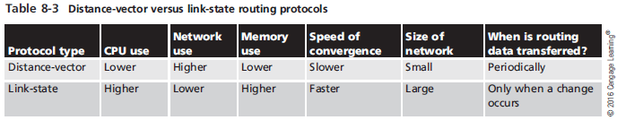
Routing Protocols
Speed of convergence refers to how fast the routing tables of all routers in an internetwork are updated when a change in the network occurs
Notes:
Routing Protocols
Speed of convergence refers to how fast the routing tables of all routers in an internetwork are updated when a change in the network occurs

Slide 37
Routing Protocols
Interior gateway protocols (IGP) are used in an autonomous system (AS)
Which is an internetwork managed by a single organization
Routing protocols discussed so far are IGPs
Exterior gateway protocols (EGP) are used between autonomous systems
Example of EGP is Border Gateway Protocol (BGP)
Known as a path-vector routing protocol, which analyzes characteristics of all Ass to form a nonlooping routing topology
Notes:
Routing Protocols
Interior gateway protocols (IGP) are used in an autonomous system (AS)
Which is an internetwork managed by a single organization
Routing protocols discussed so far are IGPs
Exterior gateway protocols (EGP) are used between autonomous systems
Example of EGP is Border Gateway Protocol (BGP)
Known as a path-vector routing protocol, which analyzes characteristics of all Ass to form a nonlooping routing topology

Slide 38
Routing Protocols
Static routes can be entered in a routing table manually
Consider the following before deciding:
Does the network change often? If so, a routing protocol is probably a good choice
Are there several alternate paths to many of the networks in the internetwork? If so, a routing protocol can reroute around down links or congested routes automatically
Is the internetwork large? A routing protocol builds and maintains routing tables automatically
Notes:
Routing Protocols
Static routes can be entered in a routing table manually
Consider the following before deciding:
Does the network change often? If so, a routing protocol is probably a good choice
Are there several alternate paths to many of the networks in the internetwork? If so, a routing protocol can reroute around down links or congested routes automatically
Is the internetwork large? A routing protocol builds and maintains routing tables automatically

Slide 39
Access Control Lists
Access Control List (ACL) – A set of rules configured on a router’s interface for specifying which addresses and which protocols can pass through an interface and to which destinations
When an ACL blocks a packet it is called packet filtering
Notes:
Access Control Lists
Access Control List (ACL) – A set of rules configured on a router’s interface for specifying which addresses and which protocols can pass through an interface and to which destinations
When an ACL blocks a packet it is called packet filtering

Slide 40
Access Control Lists
ACLs are usually configured to block traffic based on:
Inbound or outbound traffic
Source address
Destination address
Protocol
Addresses can be specific IP addresses or network numbers and filtering can be done on either source or destination address or both
Notes:
Access Control Lists
ACLs are usually configured to block traffic based on:
Inbound or outbound traffic
Source address
Destination address
Protocol
Addresses can be specific IP addresses or network numbers and filtering can be done on either source or destination address or both

Slide 41
Wireless Access Points in Depth
This section discusses some configuration options on most wireless APs and wireless routers
A wireless router is actually three devices in one:
A wireless AP
A router
A switch
Notes:
Wireless Access Points in Depth
This section discusses some configuration options on most wireless APs and wireless routers
A wireless router is actually three devices in one:
A wireless AP
A router
A switch

Slide 42
Basic Wireless Settings
Basic wireless settings on most APs:
Wireless network mode – allows you to choose which 802.11 standard the AP should operate under
Wireless network name (SSID) – when an AP is shipped the SSID is set to a default value – it is recommended that you change it upon setup
Wireless channel – recommended that you set your channels five channels apart, such as 1, 6, and 11
SSID broadcast status – by default, APs are configured to transmit the SSID so that any wireless device in range can see the network
Notes:
Basic Wireless Settings
Basic wireless settings on most APs:
Wireless network mode – allows you to choose which 802.11 standard the AP should operate under
Wireless network name (SSID) – when an AP is shipped the SSID is set to a default value – it is recommended that you change it upon setup
Wireless channel – recommended that you set your channels five channels apart, such as 1, 6, and 11
SSID broadcast status – by default, APs are configured to transmit the SSID so that any wireless device in range can see the network

Slide 43
Wireless Security Options
Most APs offer the following security options:
Encryption
Authentication
MAC filtering
AP isolation
Encryption – all private networks should use this
Most common protocols are Wired Equivalent Privacy (WEP), Wi-Fi Protected Access (WPA), and Wi-Fi Protected Access 2 (WPA2)
Use the highest level of security your systems support (all devices must use the same protocol)
Notes:
Wireless Security Options
Most APs offer the following security options:
Encryption
Authentication
MAC filtering
AP isolation
Encryption – all private networks should use this
Most common protocols are Wired Equivalent Privacy (WEP), Wi-Fi Protected Access (WPA), and Wi-Fi Protected Access 2 (WPA2)
Use the highest level of security your systems support (all devices must use the same protocol)

Slide 44
Wireless Security Options
Authentication – If used, users must enter a username and password to access the wireless network
APs that support authentication usually support the Remote Dial-In User Service (RADIUS) protocol
MAC filtering – enables you to restrict which devices can connect to your AP
Add the MAC addresses of the wireless devices allowed to access your network to a list on the AP
AP isolation – creates a separate virtual network for each client connection
Clients can access the Internet but can’t communicate with each other
Notes:
Wireless Security Options
Authentication – If used, users must enter a username and password to access the wireless network
APs that support authentication usually support the Remote Dial-In User Service (RADIUS) protocol
MAC filtering – enables you to restrict which devices can connect to your AP
Add the MAC addresses of the wireless devices allowed to access your network to a list on the AP
AP isolation – creates a separate virtual network for each client connection
Clients can access the Internet but can’t communicate with each other

Slide 45
Advanced Wireless Settings
Common advanced settings:
Adjustable transmit power – Let you control the power and range of the wireless network signal
Multiple SSIDs – Two or more wireless networks can be created with different security settings
VLAN support – To assign wireless networks to wired VLANs
Traffic priority – If your AP is configured for multiple networks you can assign a priority to packets coming from each network
Notes:
Advanced Wireless Settings
Common advanced settings:
Adjustable transmit power – Let you control the power and range of the wireless network signal
Multiple SSIDs – Two or more wireless networks can be created with different security settings
VLAN support – To assign wireless networks to wired VLANs
Traffic priority – If your AP is configured for multiple networks you can assign a priority to packets coming from each network

Slide 46
Advanced Wireless Settings
Common advanced settings (cont’d):
Wi-Fi Multimedia – Provides Quality of Service (QoS) settings for multimedia traffic, giving priority to streaming audio or video
AP modes – An AP can be set to operate as a traditional access point, a repeater, or a wireless bridge
Notes:
Advanced Wireless Settings
Common advanced settings (cont’d):
Wi-Fi Multimedia – Provides Quality of Service (QoS) settings for multimedia traffic, giving priority to streaming audio or video
AP modes – An AP can be set to operate as a traditional access point, a repeater, or a wireless bridge

Slide 47
Network Interface Cards in Depth
A NIC makes the connection between a computer and the network medium
Performance and reliability of the NIC are crucial to the computer’s network performance
Notes:
Network Interface Cards in Depth
A NIC makes the connection between a computer and the network medium
Performance and reliability of the NIC are crucial to the computer’s network performance

Slide 48
Advanced Features of NICs
If a NIC is slow, it can limit network performance
When selecting a network adapter, first identify the physical characteristics the card must match
Type of bus, type of network technology, type of connector needed to connect to media
Hardware-enhancement options:
Shared adapter memory – the adapter’s buffers map directly to RAM on the computer
Shared system memory – a NIC’s onboard processor selects a region of RAM on the computer and writes to it as though it were buffer space on the adapter
Notes:
Advanced Features of NICs
If a NIC is slow, it can limit network performance
When selecting a network adapter, first identify the physical characteristics the card must match
Type of bus, type of network technology, type of connector needed to connect to media
Hardware-enhancement options:
Shared adapter memory – the adapter’s buffers map directly to RAM on the computer
Shared system memory – a NIC’s onboard processor selects a region of RAM on the computer and writes to it as though it were buffer space on the adapter

Slide 49
Advanced Features of NICs
Hardware-enhancement options (cont’d):
Bus mastering – permits a network adapter to take control of the computer’s bus to initiate and manage data transfers to and from the computer’s memory
RAM buffering – means a NIC includes additional memory to provide temporary storage for incoming and outgoing network data that arrives at the NIC faster than it can be sent out
Onboard co-processors – enable the card to process incoming and outgoing network data without requiring service from the CPU
Notes:
Advanced Features of NICs
Hardware-enhancement options (cont’d):
Bus mastering – permits a network adapter to take control of the computer’s bus to initiate and manage data transfers to and from the computer’s memory
RAM buffering – means a NIC includes additional memory to provide temporary storage for incoming and outgoing network data that arrives at the NIC faster than it can be sent out
Onboard co-processors – enable the card to process incoming and outgoing network data without requiring service from the CPU

Slide 50
Advanced Features of NICs
Hardware-enhancement options (cont’d):
QOS allows prioritizing time-sensitive data
Automatic link aggregation
Enables you to install multiple NICs in one computer and aggregate the bandwidth
Improved fault tolerance by installing a second NIC
Failure of the primary NIC shifts network traffic to the second NIC
Advanced Configuration Power Management Interface (ACPI) offers wake-on LAN
Allows an administrator to power on a PC remotely by accessing the NIC through the network
Notes:
Advanced Features of NICs
Hardware-enhancement options (cont’d):
QOS allows prioritizing time-sensitive data
Automatic link aggregation
Enables you to install multiple NICs in one computer and aggregate the bandwidth
Improved fault tolerance by installing a second NIC
Failure of the primary NIC shifts network traffic to the second NIC
Advanced Configuration Power Management Interface (ACPI) offers wake-on LAN
Allows an administrator to power on a PC remotely by accessing the NIC through the network

Slide 51
Advanced Features of NICs
Hardware-enhancement options (cont’d):
Preboot Execution Environment (PXE) adapters allow a computer to download an OS instead of booting it from a local hard drive
Used on diskless workstations (“thin clients”) that do not store the OS locally
Typical desktop computers with basic features is usually adequate.
Servers do warrant some of these high-end features
Virtualized environments benefit from NICs with multiple ports
Notes:
Advanced Features of NICs
Hardware-enhancement options (cont’d):
Preboot Execution Environment (PXE) adapters allow a computer to download an OS instead of booting it from a local hard drive
Used on diskless workstations (“thin clients”) that do not store the OS locally
Typical desktop computers with basic features is usually adequate.
Servers do warrant some of these high-end features
Virtualized environments benefit from NICs with multiple ports

Slide 52
Firewall
A network firewall is a security device that puts up a barrier between a local network and the Internet.
The firewall acts as a filter, allowing or restricting data traffic between the network it protects and other networks.
Firewalls are flexible, allowing you to modify the blocking rules, such as by IP address, by protocol (TCP, UDP, ICMP), by port, or for software applications and services.
https://www.atlantic.net/hipaa-compliant-cloud-hosting-services/what-is-networking-basics-switches-routers-firewalls/
Notes:
Advanced Features of NICs
Hardware-enhancement options (cont’d):
Preboot Execution Environment (PXE) adapters allow a computer to download an OS instead of booting it from a local hard drive
Used on diskless workstations (“thin clients”) that do not store the OS locally
Typical desktop computers with basic features is usually adequate.
Servers do warrant some of these high-end features
Virtualized environments benefit from NICs with multiple ports

Slide 53
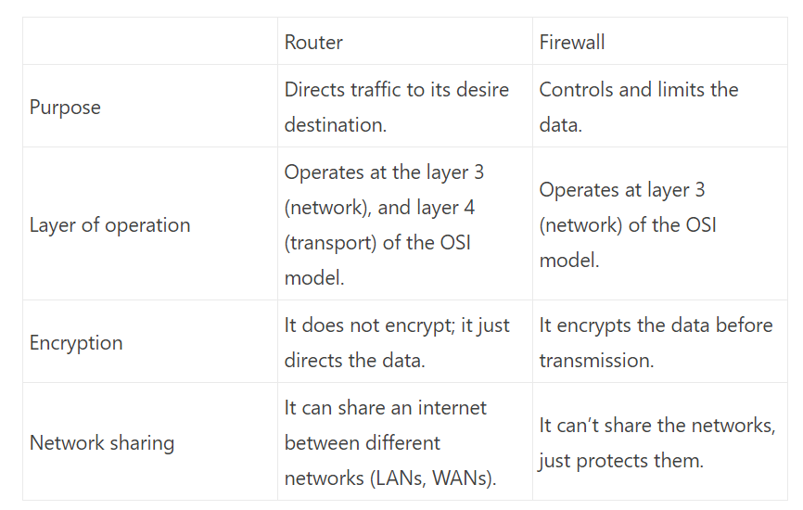
Router vs Firewall
https://www.cloudns.net/blog/router-vs-firewall-hardware-software/
Notes:
Advanced Features of NICs
Hardware-enhancement options (cont’d):
Preboot Execution Environment (PXE) adapters allow a computer to download an OS instead of booting it from a local hard drive
Used on diskless workstations (“thin clients”) that do not store the OS locally
Typical desktop computers with basic features is usually adequate.
Servers do warrant some of these high-end features
Virtualized environments benefit from NICs with multiple ports

Slide 54
Hardware firewall vs Software firewall
Both protects you from malicious traffic, but they have some differences.
The hardware firewall can be a stand-alone device or a part of a router. Such a router is a simple and effective protection solution for your network. It reviews the headers of the data packets and decides if it can be trusted. If it thinks the packet is safe, it will forward it, if no, it will drop it.
A software firewall is a program that you can install on your computer. It can be a part of an antivirus suite or separate. It will protect from uncontrolled access to your computer. Depending on the software, it can keep you safe from Trojans and worms too.
https://www.cloudns.net/blog/router-vs-firewall-hardware-software/
Notes:
Advanced Features of NICs
Hardware-enhancement options (cont’d):
Preboot Execution Environment (PXE) adapters allow a computer to download an OS instead of booting it from a local hard drive
Used on diskless workstations (“thin clients”) that do not store the OS locally
Typical desktop computers with basic features is usually adequate.
Servers do warrant some of these high-end features
Virtualized environments benefit from NICs with multiple ports

Slide 55
Hardware firewall vs Software firewall
The difference with the hardware one, this one will protect just the device that has the firewall installed.
If you need a firewall on all of your devices, you would need to install it on all of them.
Another disadvantage of it is that it will run in the background, which will take some system resources and may lead to slowdowns.
https://www.cloudns.net/blog/router-vs-firewall-hardware-software/
Notes:
Advanced Features of NICs
Hardware-enhancement options (cont’d):
Preboot Execution Environment (PXE) adapters allow a computer to download an OS instead of booting it from a local hard drive
Used on diskless workstations (“thin clients”) that do not store the OS locally
Typical desktop computers with basic features is usually adequate.
Servers do warrant some of these high-end features
Virtualized environments benefit from NICs with multiple ports

Slide 56
Summary
Network switches use auto-negotiate mode to determine the link speed and duplex mode.
Switching tables can hold many more MAC addresses than ports
Switches forward frames by using a variety of methods – cut-through, fragment-free, and store-and-forward
Advanced features, such as VLANs, STP, multicast support, and port security are found on smart switches
Notes:
Summary
Network switches use auto-negotiate mode to determine the link speed and duplex mode.
Switching tables can hold many more MAC addresses than ports
Switches forward frames by using a variety of methods – cut-through, fragment-free, and store-and-forward
Advanced features, such as VLANs, STP, multicast support, and port security are found on smart switches

Slide 57
Summary
Multilayer switches can perform some of the same tasks as routers and offer a substantial performance advantage
Routing tables contain destination networks, next hop addresses, metrics, methods used to derive routes, and timestamps
Routing protocols populate routing tables dynamically. The most common type of routing protocols are distance-vector and link-state
Routing protocols can be interior gateway protocols or exterior gateway protocols
Notes:
Summary
Multilayer switches can perform some of the same tasks as routers and offer a substantial performance advantage
Routing tables contain destination networks, next hop addresses, metrics, methods used to derive routes, and timestamps
Routing protocols populate routing tables dynamically. The most common type of routing protocols are distance-vector and link-state
Routing protocols can be interior gateway protocols or exterior gateway protocols

Slide 58
Summary
Access points have the following basic settings: wireless mode, SSID, and wireless channel
Higher-end APs can support advanced features, such as multiple SSIDs, adjustable transmit power, VLANs, QoS, and repeater and bridge modes
NIC selection includes the PC bus
Some advanced NIC features to consider include RAM buffering, onboard co-processors, automatic link aggregation, and multiple ports for fault tolerance
Notes:
Summary
Access points have the following basic settings: wireless mode, SSID, and wireless channel
Higher-end APs can support advanced features, such as multiple SSIDs, adjustable transmit power, VLANs, QoS, and repeater and bridge modes
NIC selection includes the PC bus
Some advanced NIC features to consider include RAM buffering, onboard co-processors, automatic link aggregation, and multiple ports for fault tolerance

